Slide 1
Hinged Mud Rings

Slide 2
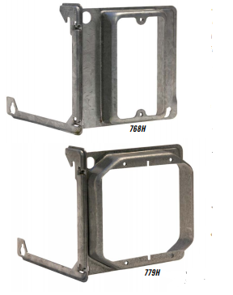
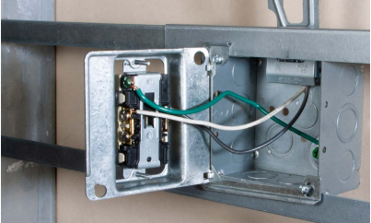
Application
Hinged design allows device to be mounted to the ring before install and swing design frees up both hands of the installer.

Slide 3
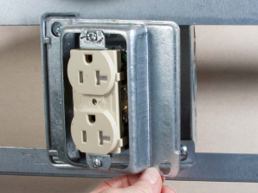
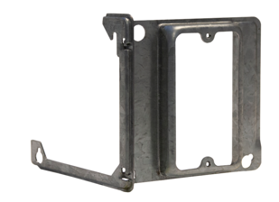
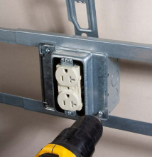
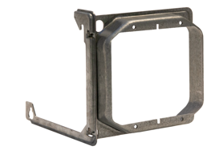
Features & Benefits
Unique design allows mud ring to be opened in the field
1-Gang and 2-Gang versions for 4” square boxes
Hinged design allows for quick and easy access to install conduit connectors and wiring
Mounts to box with out having to remove cover mounting screws
Available in ½” , 5/8”, and ¾” raised depths

Slide 4
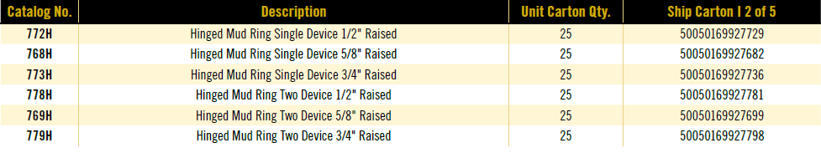
Current Line up
Currently developing a line of 4-11/16” Hinged mudrings as well as a line of Hinged Adjustable in 4” and 4-11/16”

Slide 5
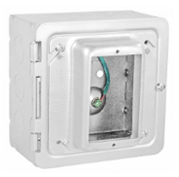
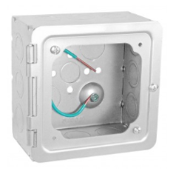
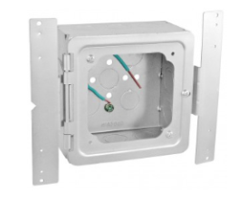
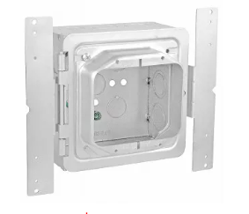
Competition
Garvin offers a 5”box with a hinged door and then you can use any mud ring or cover on it.
Only 1 size box offered – 5”Sq - 3” deep – ½ &3/4 KO’s
Can not be used with Open Center Bracket
Offer preassembles versions available

Slide 6
Adjustable Mud Rings

Slide 7
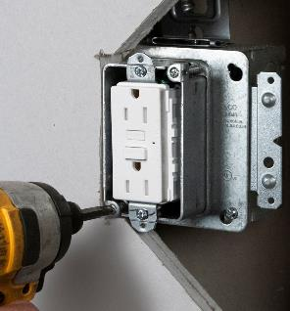
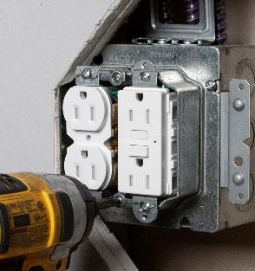
Application
RACO Adjustable Mud Rings provide job site flexibility when finished wall depths are unknown
Inner ring can be adjusted after drywall is installed to match depth, saving the installer time.

Slide 8
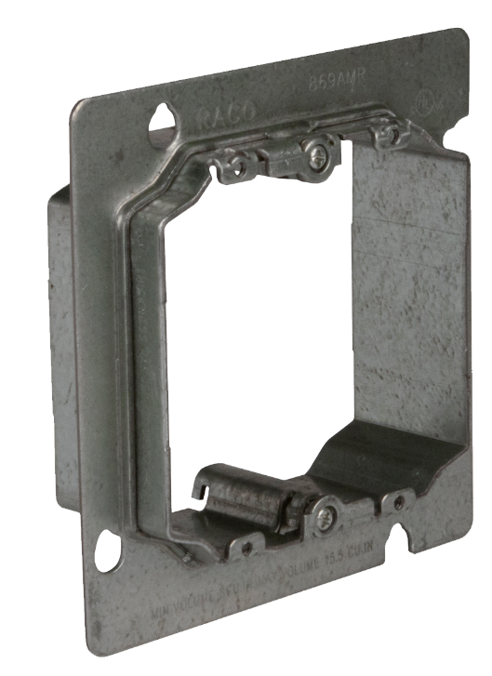
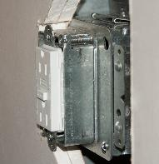
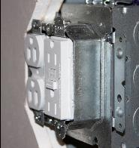
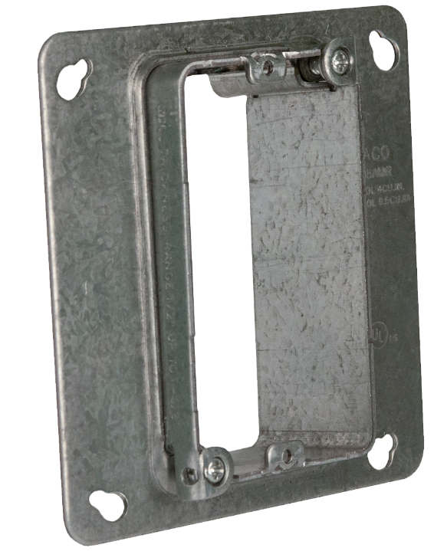
Features & Benefits
Available for 4” square and 4-11/16” square boxes
½” to 1-3/8” adjustability range
Depth adjusted by 2 screws located on opposite sides
All screws inside of ring eliminating damage from router
For use with 2-1/8” deep boxes
cULus Listed

Slide 9
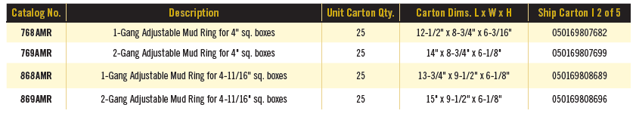
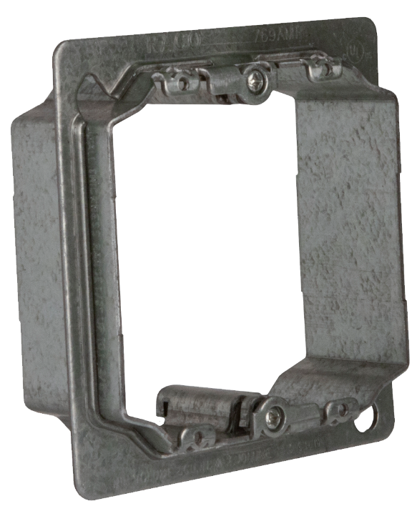
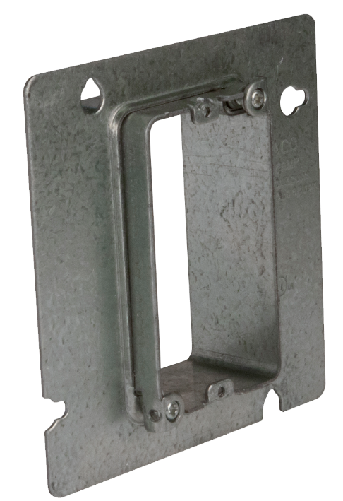
SKU Offering / Packaging Info

Slide 10
Cross Reference
*Denotes non-UL Listed product
RACO offers industries largest adjustability range on UL listed 4-11/16” Adjustable Mud Rings

Slide 11
Adjustable Mud Rings
Tear and Compare:
RACO v Frasier Oaks

Slide 12

Side by Side Comparison
Advantage RACO

Slide 13
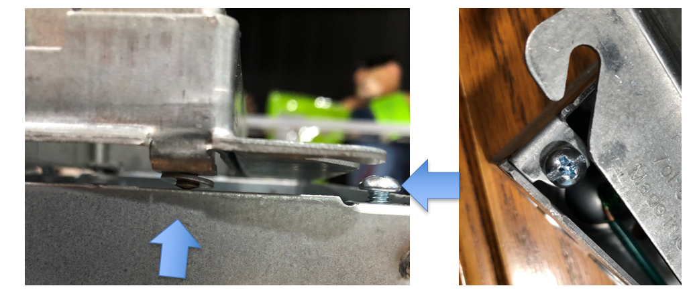
Single Gang Installation Issue on Boxes
Adjustment tab interferes with box during installation
Screw has to be backed out almost all the way
Labor Intensive

Slide 14
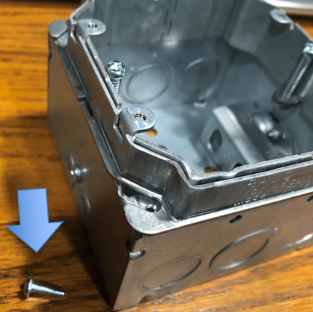
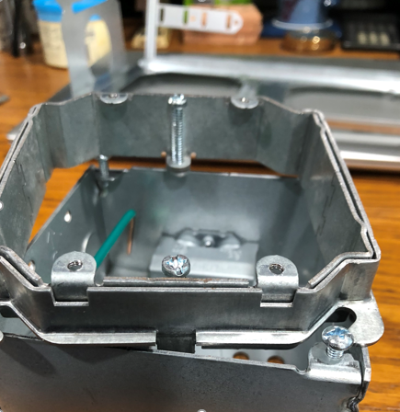
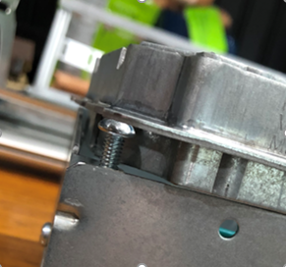
Two Gang Installation Issue on Boxes
Sleeve interferes with box
Screw must be completely removed to install cover
Labor Intensive

Slide 15
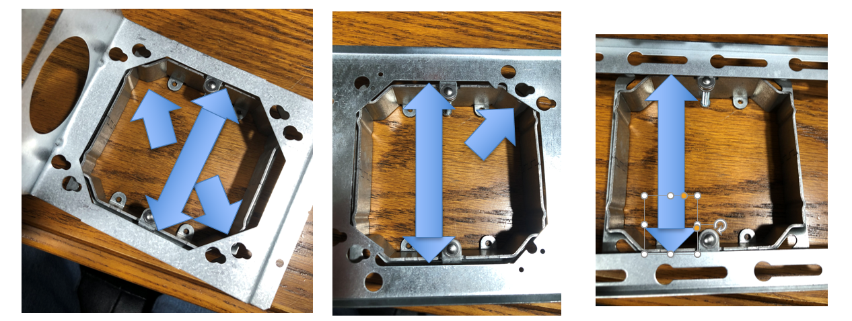
Two Gang Installation Issue on Box Positioning Brackets
Caddy H23 Bracket
Caddy 3 Position Bracket
Big “O” Bracket
Limited Uses

Slide 16
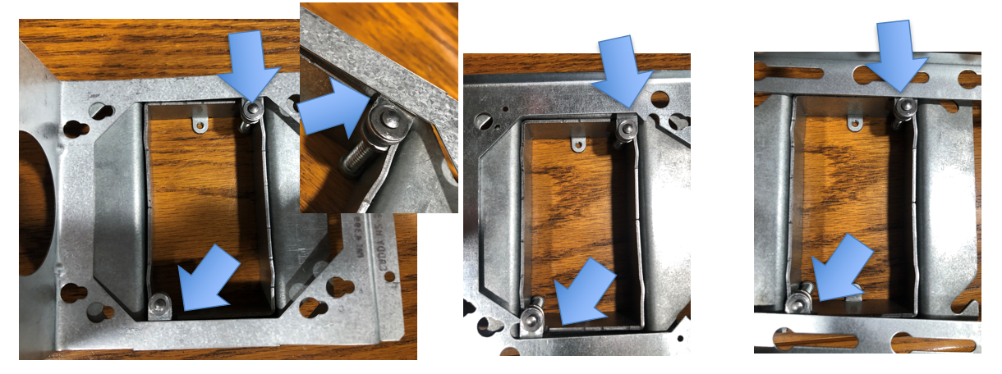
Single Gang Installation Issue on Box Positioning Brackets
Caddy H23 Bracket
Caddy 3 Position Bracket
Big “O” Bracket
Limited Uses

Slide 17
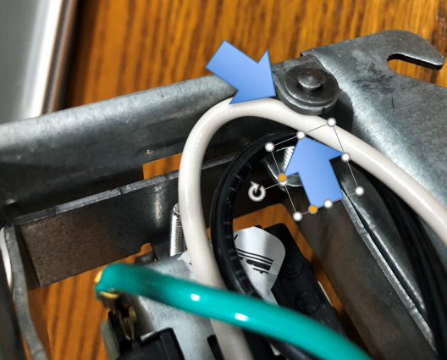
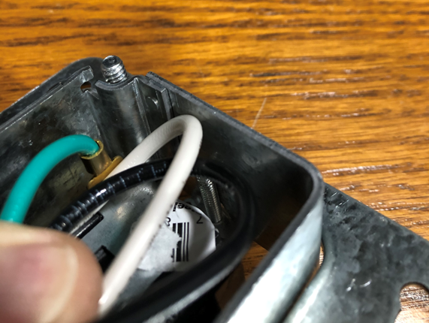
Adjustment Screw Tab and Threads
Exposed sharp edges and threads
Frasier Oaks
Clean smooth surfaces
RACO
Potential Shorts

Slide 18
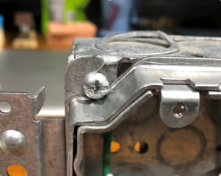
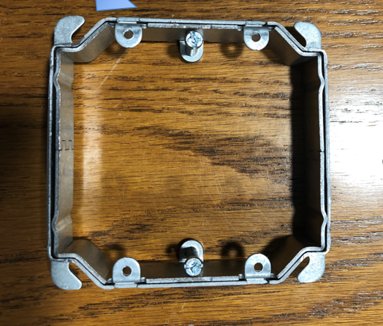
What’s Wrong With This Picture?
Mounting slot is upside down!
Ever heard of a NEMA Standard?

Slide 19
Questions?

